Slide 1
How To Review Literatures
COURSE: RESEARCH METHODOLOGY and SCIENTIFIC WRITING,
FACULTY OF COMPUTER SCIENCE , UNIVERSITY OF INDONESIA
Disampaikan oleh:
Tim Pengajar MPPI

Slide 2
Review Previous Sessions: Research Understanding
Penelitian adalah….. “Kegiatan pengumpulan, pengolahan, analisis, dan penyajian data yang dilakukan secara sistematis dan objektif untuk memecahkan suatu permasalahan.
Langkah-2 sistematis dan objektif tersebut dilakukan dengan penalaran yang logis.
Langkah-2 yang sistematis dan objektif dalam menyelesaikan penelitian disebut Metodologi.
Penelitian selalu dimulai dengan mengidentifikasi masalah (problem), isu (issue), peluang (opportunity) penelitian, yang memerlukan solusi.

Slide 3
Pengertian Penelitian…..
Dari definisi tersebut, penelitian tidak bisa dipisahkan dari ke-3 hal berikut ini:
Harus dimulai dengan rumusan masalah, isu, peluang, atau fenomena yang jelas (well define). Membuat aplikasi untuk meramal cuaca bukanlah penelitian, tetapi cuaca dipengaruhi banyak faktor. Bagaimana berbagai faktor tersebut berinteraksi sehingga cuaca bisa diramal, adalah suatu penelitian.
Masalah, isu, atau fenomena ini harus diteliti (dicarikan pemecahannya atau jawabannya) secara sistematis dan logis dengan menggunakan teknik, metode, proses dan prosedur yg terdefinisikan dengan jelas (well define).
Pemecahan secara sistematis dan logis tersebut harus menggunakan data yang objektif (kuantitatif dan/atau kualitatif), dan data harus dikumpulkan dengan instrument yang sahih (valid) dan reliable.

Slide 4
Data Yang Objektif
Data dapat berupa: angka, simbol, gambar, rekaman suara, rekaman video, skala, dll., (data kuantitatif maupun kualitatif).
Data disajikan dalam bentuk tabel, grafik, gambar, dll.
Data yang objektif, diperoleh secara ilmiah, yaitu dengan menggunakan berbagai instrument yang terdefinisikan dengan jelas (valid dan reliable).
Hasil experiment, hasil pengamatan dengan alat tulis, alat rekaman, hasil wawancara dengan pertanyaan tertulis yang terdokumentasi, hasil survey dengan kuesioner yang terdokumentasi, dll.

Slide 5
Motivasi Mereview Literature…..
Suatu penelitian tidak berdiri sendiri:
Penelitian dibangun dari penelitian sebelumnya.
Penelitian membentuk “niche” tersendiri yang merupakan lingkungan intelektual dari “theme” penelitian tersebut.
Untuk merekonstruksi penelitian sebelumnya, perlu mereview hasil-hasil penelitian sebelumnya.
Disinilah perlunya mempelajari bagaimana mereview literature.

Slide 6
Session Objectives
To understand how to search relevant literatures.
To understand the objectives of reviewing literatures
To understand the processes of reviewing literatures.
To understand the components of literature to be reviewed.
To understand the state-of-the-art literatures related to the problem statement.

Slide 7
General Model of Scientific Inquiry
We are here….How to
Search and Review
Literature
State General Problem
Conduct Literature
Search
State Specific Problem
Design Methodology
Gather Data
Analyze Data
Report Results
Refine Hypotheses

Slide 8
Characteristics of Scientific Inquiry
Based on facts as opposed to “imagination”
Objective consideration as opposed to subjective consideration.
Analytical as opposed to “trivial” or “adhoc”.
Quantitative in Nature (can be measured. Qualitative research has measurement also).
Using Deductive Logic-Hypothesis (general to specific approach) or Inductive Logic-Generalization (specific to general approach).

Slide 9
Activities in Scientific Inquiry
Making observations instead of “wondering around”.
Posting questions to all possible problems or issues or opportunities.
Finding out what is already known in order to avoid from re-inventing wheel.
Planning investigations as part of steps in methodology.
Reviewing past knowledge in light of experimental evidence in order continuity.
Using tools to gather, analyze, and interpret data so that data can be justified (dapat dipertanggung jawabkan)
Proposing analysis, interpretation and explanations to the problems of interest.
Communicating the results through research report and publications.

Slide 10
Logical Flow of General Problem to Review Literature
The statement of general problem(s) as the basis to find related literatures.
At this state, the nature of the problem(s) still shaky, hesitated, and blurred.
Reviewing literatures will enhance the statement of the problem(s), issues, opportunities.
Literatures reviewed have to have logical and semantical connection to the problems statement.
Finding and reviewing related literatures are an art as well as a scientific acts.

Slide 11
What is A Literature Review? (source University Library, University of California)
It is a surveys of scholarly articles, books and other sources (e.g. dissertations, journal, conference proceedings) relevant to a particular issue, area of research, or theory.
Textbook, magazine, Bulletin are not suggested!!
It is providing a description, summary, and critical evaluation of each work (each research article).
The purpose is to offer an overview of significant literatures published on a topic (overview the state-of-the-art).

Slide 12
Definition (Source: Wikipedia)..
A Literature review is a body of text that aims to review the critical points of current knowledge (state-of-the-art) on a particular topic.
Most often associated with science-oriented literature, such as a thesis, the literature review usually precedes a research proposal, methodology and results section.
Its ultimate goal is to bring the reader up to date with current literature on a topic and forms the basis for another goal, such as the justification for future research in the area.

Slide 13
Definition (Source: Wikipedia)
A good literature review is characterized by:
a logical flow of ideas;
current and relevant references with consistent, appropriate referencing style (IEEE style, APA style, Chicago style, etc.);
proper use of terminalogy;
and an unbiased and comprehensive view of the previous research on the topic.

Slide 14
How to Find Relevant Literatures?
Search with the key-word of the resesearch topic.
Use broader key-word (term) if the documents retrieved are few or none, or use narrower key-word if the documents retrieved are too much (consult thesaurus).
Use synonim or related terms to enhance the search
Employ Boolean operator: AND, OR, NOT to control the search (these operators are unseen in many search engines).
Searching is part of science in Information Retrieval
Extracting automatic key-word (index) is part of science in Text Processing.
Using Broader Term, Narrower Term, Related Term, etc. are parts of Thesaurus

Slide 15
Algorithm to Find Related Literatures
Determined the research topic.
Pick the most recent article related to that topic.
Read the article thoroughly
Take a note on important problems, issues, techniques, analysis, finding, and conclusions.
Start look for another related articles through:
New search terms (key words) found in the related articles
List of references in the chosen article
Form a body of literatures pertinent to the topic.
Span of time (from time to time: old time to the recent time)
Span of topic (one topic may related to another topics)

Slide 16
Example: The Research Topic is on E-Government
Industry, policies, economy
Related topic to: Environment of Organization XYZ
Related topic to:
IT trend and Organization Respond
IT Penetration
IT Organization
The Topic:
Optimalization of E-Government Impementation
Review all literatures related to: IT trend, Eco System, E-Gov cases, and Methodology
Related topic to: Cases of E-Gov
Related topic to: Methodology, Method, teknik used for E-Gov

Slide 17
The Objectives of Reviewing Literatures? (source University Library, University of California)
Place each work (research article) in the context of its contribution to the understanding of the subject under review
Describe the relationship of each work to the others under consideration
Identify new ways to interpret, and shed light on any gaps in, previous research
Resolve conflicts amongst seemingly contradictory previous studies
Identify areas of prior scholarship to prevent duplication of effort
Point the way forward for further research
Place one's original work (in the case of theses or dissertations) in the context of existing literature

Slide 18
Why doing a literature review?
To identify gaps in the literature.
To avoid reinventing the wheel (at the very least this will save time and it can stop you from making the same mistakes as others).
To identify methods that could be relevant to your project.
To carry on from where others have already reached (reviewing the field allows you to build on the platform of existing knowledge and ideas).
To identify other people working in the same fields (a researcher network is a valuable resource).
To increase your breadth of knowledge of your subject area.

Slide 19
Cont….Why doing a literature review?
To identify similar works in your area.
To provide the intellectual context for your own work, enabling you to position your project relative to other work.
To identify opposing views.
To put your work into perspective.
To demonstrate that you can access previous work in an area.
To identify information and ideas that may be relevant to your project.

Slide 20
Stages of Literature Reviews (source University Library, University of California)
Problem formulation—which topic or field is being examined and what are the issues?
Literature search—finding materials relevant to the subject being explored.
Data evaluation—determining which literature makes a significant contribution to the understanding of the topic.
Analysis and interpretation—discussing the findings and conclusions of pertinent literature.

Slide 21
Elements of Literature to Review
An overview of the subject, issue or theory under consideration, along with the objectives of the literature review
Division of works under review into categories (e.g. those in support of a particular position, those against, and those offering alternative theses entirely)
Explanation of how each work is similar to and how it varies from the others
Conclusions as to which pieces are best considered in their argument, are most convincing of their opinions, and make the greatest contribution to the understanding and development of their area of research

Slide 22
Techniques to Review Literatures
Compare: try to find the similarities among literatures
Explain how each article similar to the others.
Contrast: try to find the differences among literatures
Explain how each article differ to the others
Criticize: put your own opinion on what is written in the literatures. Do not hesitate to write your opinion!!!
Criticize the strength and weakness of the research
Synthesize: combine several literatures into an idea
Summarize: restate the article with your own words in a concise way

Slide 23
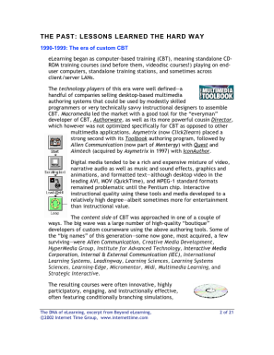
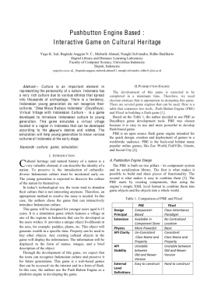
Examples : Comparing
“Menurut penelitian yang dilakukan oleh Andri (1999), kinerja IRS dengan menggunakan teknik Extended Boolean lebih baik dibanding menggunakan teknik Boolean saja. Hal ini sejalan dengan hasil-hasil penelitian sebelumnya yang dilakukan oleh Savoy (1995), Salton (1990), dll.”
Andri, 1999
Si penulis meng-”compare
paper Andri, Savoy dan
Salton (mencari yg sama)
Salton, 1990
Savoy, 1995

Slide 24
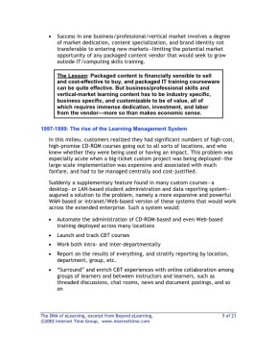
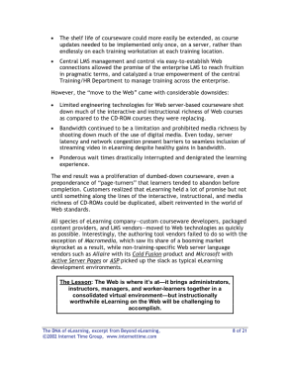
Examples : Contrasting
“Hasil penelitian yang dilakukan oleh Santoso (2006) menunjukkan bahwa gaya belajar konstruktif lebih adaptif terhadap penggunaan ICT. Hal ini bertentangan dengan hasil penelitian lainnya yang mengatakan bahwa gaya positivist yang lebih adaptif terhadap penggunaan ICT (Ford, 1998; Huge, 2001”).
Santoso, 2006
Si penulis meng-”cotrast”
paper Santoso, dengan Ford
Dan Huge (mencari perbedaannya)
Ford, 1998
Huge, 2001

Slide 25
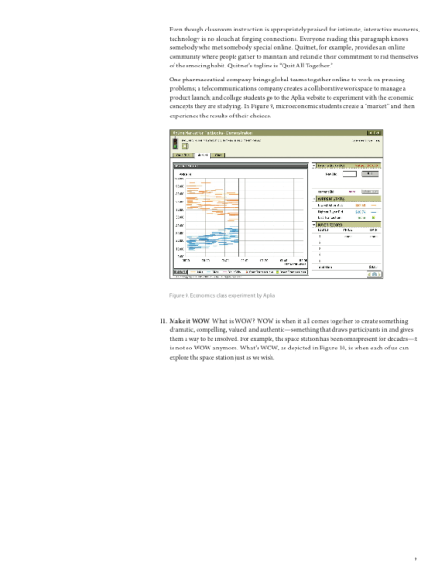
Examples : Criticize
Menurut Hadi (2005) Sistem Informasi Untuk Eksekutif (EIS) dapat membantu pimpinan mengambil keputusan lebih akurat sekitar 90% dibanding tidak menggunakan EIS, tetapi tidak dijelaskan berapa banyak sample EIS yang disurvei dan kategori keputusan yang bagaimana yang dijadikan sebagai acuan.
Si penulis mengkritik
paper Hadi,
(mencari kelemahan)
Hadi, 2005

Slide 26
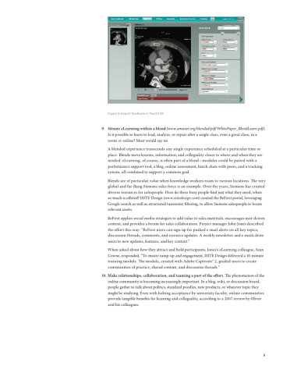
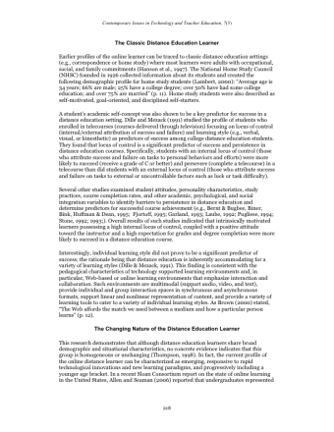
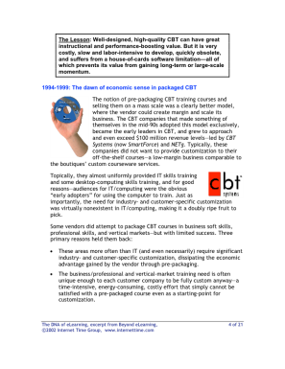
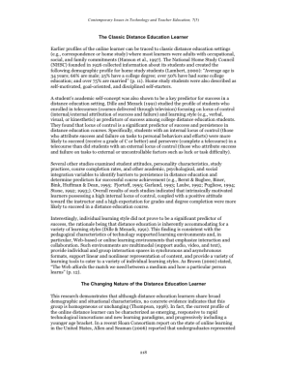
Examples : Synthesize
“Menurut Hadi (2005) keberhasilan suatu Sistem Informasi Untuk Eksekutif (EIS) sangat ditentukan oleh tingkat ke akuratan menangkap kebutuhan para eksekutif sedangkan menurut Amir (2006), EIS sangat ditentukan oleh kejelasan core bisnis dari perusahaannya. Dari kedua pendapat tersebut, dapat dikatakan bahwa faktor-2 penentu keberhasilan EIS antara lain: keakuratan menangkap kebutuhan pimpinan, dan kejelasan core bisnis perusahaan”
Synthesize:
combine several literatures into an idea
Hadi, 2005
Amir, 2006

Slide 27
Where to Place Your Literature Review?
Usually it’s placed at Chapter 2 of your thesis or dissertation.
A literature review may constitute an essential chapter of a thesis or dissertation.
Literature review should logically connected to research problems, research methodology, analysis and conclusion.
Beside that, from reviewing literatures, you can write a review paper.

Slide 28
Getting Started
Like many tasks, reading and starting to write review literature usually seems worst before you begin
So you should make a start
First make up an outline—just sit and type points to review
Organization. It is encouraging and helpful to start a filing system
Timetable. a list of dates for when you will give the first and second drafts
Iterative. it is easier, however, to improve something that is already written than to produce text from nothing

Slide 29
Points to Consider When Reviewing a Literature… (source University Library, University of California)
Provenance—What are the author's credentials? Are the author's arguments supported by evidence (e.g. primary historical material, case studies, narratives, statistics, recent scientific findings)?
Objectivity—Is the author's perspective even-handed or prejudicial? Is contrary data considered or is certain pertinent information ignored to prove the author's point?
Persuasiveness—Which of the author's theses are most/least convincing?
Value—Are the author's arguments and conclusions convincing? Does the work ultimately contribute in any significant way to an understanding of the subject?

Slide 30
Points to Discuss in Literature Review: Among others
What is the problem and why is it important?
Is the problem clearly defined?
Try to state the problem as simply as you can
Is the research methodology well stated?
How’s the data being created and manipulated?
Is the manipulated data sufficiently interpreted?
What are the techniques, methods use?
What is the contribution of the study?
Is the conclusion related to the problems?
Is the evidence sufficient enough to support conclusion?
Etc.

Slide 31
Example of Summary Literatures Review: Topic of E-Business
Components to review | Factors from literature review
Business motivation | Owner/manager’s desire for growth Owner/manager’s entrepreneurial objectives Foresight and strategy for e-business International orientation Pressures from competitors, suppliers, and customers
Enterprise culture | Attitude towards innovation Concerns about security Time to implement Management support Inertia/resistance to changing work practices
Financial resource | Implementation costs Financial allocation Financial risks attitude
Knowledge and competencies | Perceived benefits of e-business Expertise in e-business Perceived compatibility of e-business Knowledge of benefits & experience implementation Perceived complexity of e-business Process maturity

Slide 32
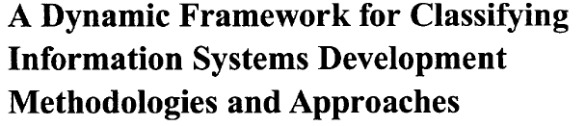
Partial Example of Literature Review
The Title of the article

Slide 33
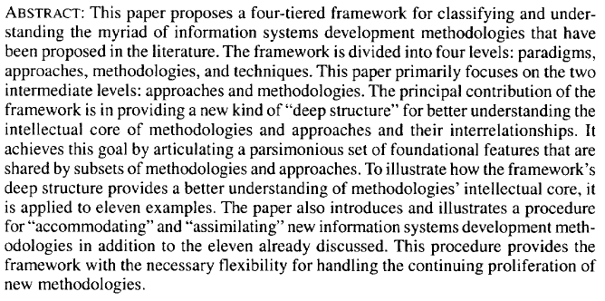
C
r
i
t
i
z
e
Synthesize
S
u
m
m
a
r
i
z
e
C
o
m
p
a
r
e
Contrast

Slide 34
Benefits of Doing Literature Review
To avoid the ambiguity of research problems.
To ensure the chosen research problems are researchable.
To show how “hot” the research problems.
To depict the “intellectual environment” of the research problems.
To acknowledge the intellectual social network related to the research problems.
To form the mosaic of your research among other.

Slide 35
Success Story….
On Wednesday, January 15, 2014 5:47 PM, JNIT <jnit@aicit.org> wrote: Dear Researcher Sfenrianto, Researcher Sfenrianto, Researcher Nungki Selviandro, Researcher Zainal A. Hasibuan, Researcher Heru Suhartanto, Congratulations! We are pleased to inform you and your colleagues that your paper, An Approach for Learning Type Triple-Factor In e-Learning Process, is accepted by JNIT: Journal of Next Generation Information Technology.

Slide 36
Comments: Information for the Contribution
1. Writing Skill and Quality (0-10): 8 2. Quality of content (0-10): 8 3. Fitness of title (0-10): 9 4. Significance for theory or practice (0-10): 5. Contribution and Originality (0-10): 9 6. Level of Innovation (0-10): 8 7. Quality of presentation (0-10): 7 8. Ripple effect to other authors (0-10): 9 9. Decisive overall recommendation (0-10): 8 This paper is an interesting work. The topics discussed in the manuscript make contributions to the study and application in the subject domain. There are a few of mistakes in both grammar and content so the authors of this paper need to check and edit it.

Slide 37
Exercise
Determine a general research problem of your interest
Search literatures related to research problem
Evaluate documents retrieved
Determine relevant documents
Enhance general research problem into several specific research problems (research questions)
Extend the literature search
Form a mosaic of body of literatures related to the research topic.

Slide 38
Q/A
TIP
If you don’t understand something
ask me!

